Slide 1
SCHOLARSHIPS 101
Gina Kelley & Lesley Hernandez

Slide 2
WHAT DO I NEED TO APPLY FOR SCHOLARSHIPS?
Most scholarships will ask for:
Activity Sheet
Letters of Recommendation
Personal Statement
Transcript
SAT/ACT Scores

Slide 3
ACTIVITY SHEET
Contact Information
Full name, mailing address, email, telephone, etc.
Educational Information and Activities
School name, expected graduation date, GPA,
Awards and honors
Extra Curricular Activities
Clubs, leadership positions, community service, conferences, job shadow, etc.
Include years of participation for each
Work Experience
Brief description,
Hobbies
Qualities

Slide 4
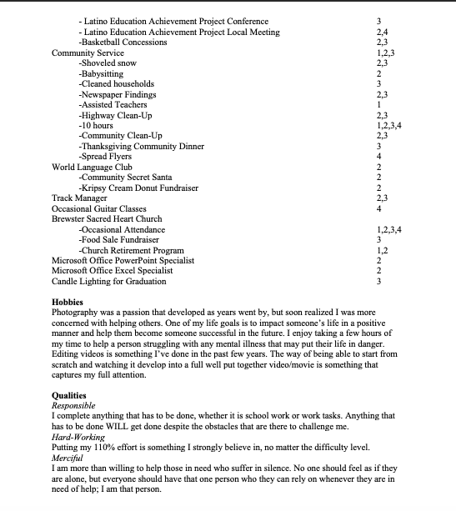

Slide 5
LETTERS OF RECOMMENDATION
FIRST RULE – CANNOT USE A RELATIVE!
Should be someone who knows you well and can say good things about you
Teachers, club sponsors, coaches, counselors, community leaders
ASK EARLY!
Giving them 2-3 weeks in best
ASK THEM TODAY – Right after we’re finished here ☺
PROVIDE ADDITIONAL INFORMATION
Copy of Recommendation Form or Activity Sheet
FOLLOW UP WITH THEM
Help them to help you by keeping them accountable
Be professional – polite, respectful and direct – let them know exactly what you need them to do and when you need it done by
SEND A THANK YOU LETTER

Slide 6
PERSONAL STATEMENT
Tell YOUR story!
COMPETITIVE
You need to make yourself stand out amongst your peers
BRAGGING RIGHTS – Don’t hold back on your accomplishments and experiences. Everyone shares different stories for these topics.
Essay should have 3 sections; introduction, body, and conclusion
The body consists of up to 4 parts: family, obstacles, community service, and life interest
i.e. death, birth order, first generation, divorced parents, single parent household, large family, migrant lifestyle, shyness, learning English, new country, or financial.
If you don’t share personal stories with them, then they can’t get to know you.
Vulnerability = The Key
Don’t blend with the crowd
Treat your essays like a mini-written-interview
Confidentiality
HANDOUTS – Writing the Winning Scholarship Essay & Essay Examples
Notes:
- Never start with “Hello, my name is…” - Always catch the reader’s attention and interest. - Essay must be unique and stand out. - It can ask a question, describe an engaging scene, state a fact, be a quote that been emphasized by a friend or relative, or be related to a life obstacle.

Slide 7
HOW DO I FIND SCHOLARSHIPS?
There are three primary sources:
Internet search sites. Link to several are on our school website.
College financial aid offices
BHS Student Support Staff/Faculty
Counselor – Ms. Kelley
Student Success Coordinator – Ms. Medved
GEAR UP Site Director – Ms. Hernandez

Slide 9
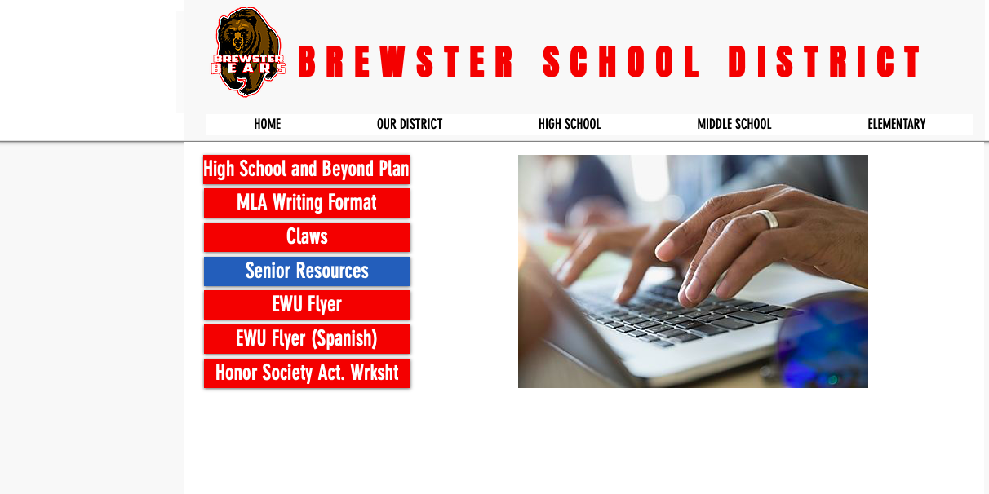
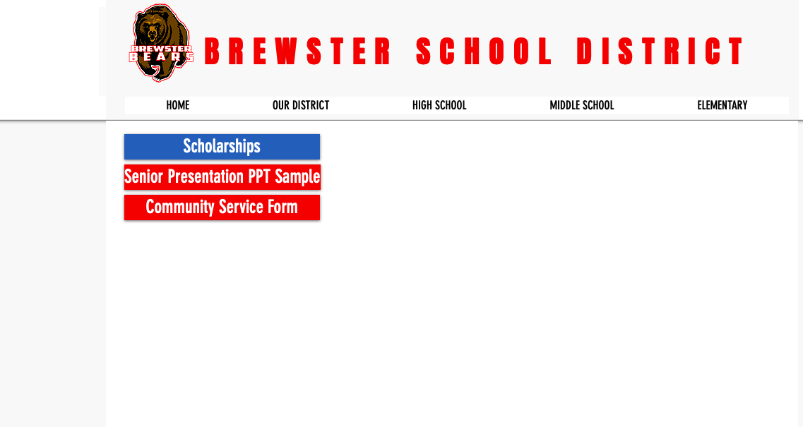

Slide 12
DID YOU KNOW?
Various University and Community College’s have additional scholarship applications that you need to apply for.
To name a few:
Wenatchee Valley College, due February 14th and the online application can be found at: https://wvc.awardspring.com/
Central Washington University, due February 1st and the online application can be found at: https://www.cwu.edu/scholarships/scholarship-central
Eastern Washington University, due February 1st and the online application can be found at: https://www.ewu.edu/apply/tuition/scholarships/
Washington State University, due January 31st and the online application can be found at: https://financialaid.wsu.edu/scholarships/

Slide 13
OTHER
Washington State Opportunity Scholarship – DUE Feb. 6th & July 1st
Must be majoring in a Science, Technology, Engineering, Math, or Health Care field
Washington Apple Education Foundation Scholarship – DUE March 1st
Eligible for students tied to Washington's tree fruit industry (apples, pears, or cherries)
Community Foundation of North Central Washington – DUE March 1st
Over 100 scholarships available for all types of students
Washboard.org
FAFSA

Slide 14
FILLING OUT YOUR APPLICATION
WHAT TO DO
WHAT NOT TO DO
Read the entire scholarship application
Research the mission statement of the scholarship – How do you relate?
Follow the Directions!
Include ALL of the requirements in your application
Watch for “postmarked by…” dates
Use correct capitalization and grammar, and spelling
If you and another candidate are the final two in the running, what it all comes down to is PRECISION
Don’t wait until the last minute to start/finish the application
Don’t be shy and hold back good information about yourself because you feel awkward talking about yourself
Don’t leave any spaces blank
Don’t be dishonest
Don’t fill out an application in pencil
Never pay money to submit a scholarship application
Don’t submit an application incomplete

Slide 15
QUESTIONS?

